Slide 1
Rotary District 6560
November 2016
Kurt Andre’

Slide 2
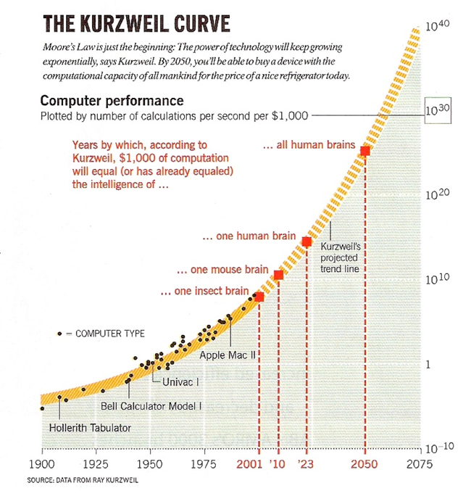
Change is Accelerating

Slide 3
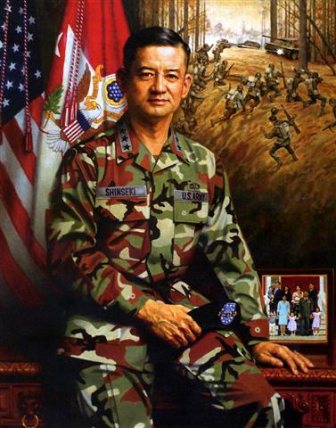
“If you don’t like change, you’ll like irrelevance even less…”

Slide 4
Failure Rate of Change
70% - 80% of change initiatives fail
60% - 80% of mergers or acquisitions fail
50% - 80% of innovation efforts fail
After 5 years 50% of start up businesses fail
After 10 years 70% of start up businesses fail

Slide 5
They have urgency… where is it?
Is there something we’re doing that doesn’t present us as attractional to the next generation?
What’s wrong with these millennials and why won’t they join us?

Slide 6
Change Formula

Slide 7
Disequilibrium

Slide 9
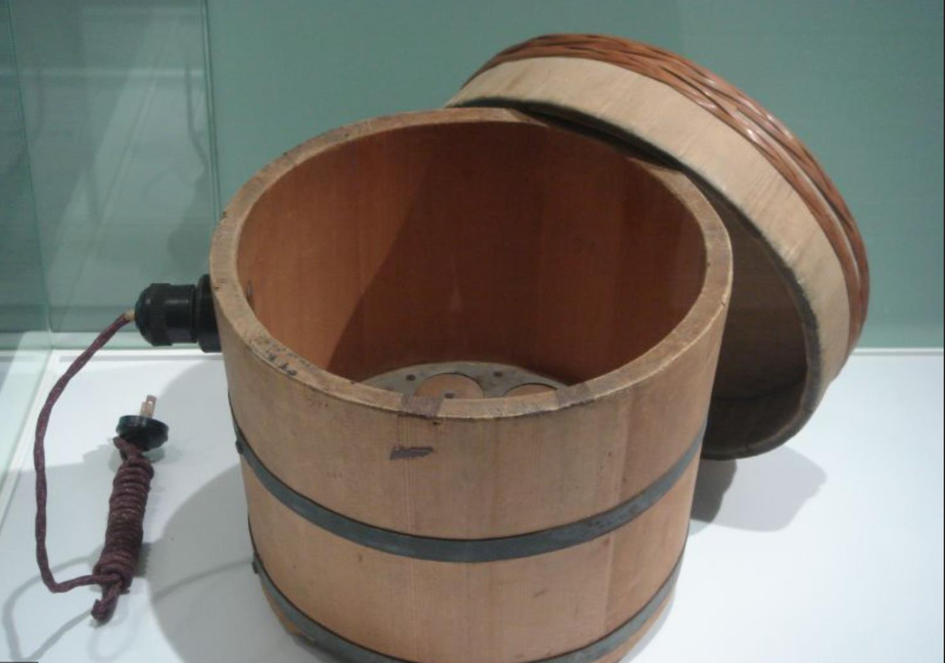

Slide 10
Compelling Vision
“To be the company that best understands and satisfies the product, service and self-fulfillment needs of women – globally,”
Our vision is to be earth’s most customer centric company
Our history is rich. Our future is dynamic. We are _______ and the spirit of invention is what drives us.
To put joy in kids’ hearts and a smile on parents’ faces.
Helping People Around the World Eat and Live Better.
To bring inspiration and innovation to every athlete in the world.
To make people happy!
Worldwide Leader in retail.

Slide 11
Path Forward

Slide 12
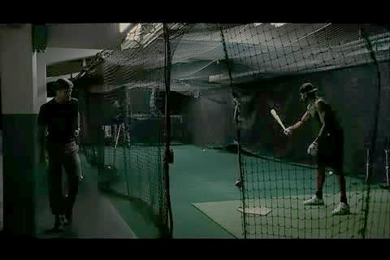
Tacit Leadership

Slide 13
Cost of Change
Change always involve loss…
Sometimes it’s the loss of irresponsibility
Organizational resistance
Preserve the Code, Stimulate progress

Slide 14
The Well-Defined Leader
Resistance
Conflict
Boundaries
Pacing
Authority

Slide 15
Thank You
“Life is too precious to spend unnecessary moments in misery.
Whatever you do, make it sweet!”
—Candace Fitzpatrick
Kurt André
kandre@tagconsulting.org
703-200-3495

